Slide 1
Introduction to OOPS
Name -vishal KUMAR singh
Roll no:- D21512 ( Lateral Entry )
Submitted to:- Dharmveer sir
KATIHAR ENGINEERING COLLEGE, KATIHAR

Slide 2
Object-oriented programming
Object-oriented programming As the name suggests uses objects in programming. Object-oriented programming aims to implement real-world entities like inheritance, hiding, polymorphism, etc in programming.
The main aim of OOP is to bind together the data and the functions that operate on them so that no other part of the code can access this data except that function.
OOPs makes code easy to debug and enhances the cooperation between developers.

Slide 3
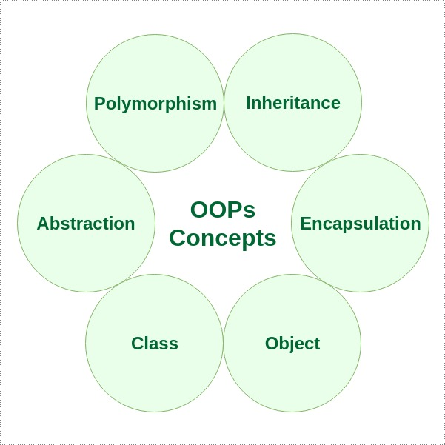
Concepts in OOPS

Slide 4
Polymorphism
Polymorphism is one of the core concepts of object-oriented programming (OOP) and describes situations in which something occurs in several different forms.
In computer science, it describes the concept that you can access objects of different types through the same interface.
Each type can provide its own independent implementation of this interface
For example:- There are different way of adding integer and different for complex number.

Slide 5
For example:-
5 + 8 = 13 “Amitabh ” + “Bachchan” = “Amitabh Bachchan”
“5”+”8” = “58”
There is two difference ways of performing addition between integers and Strings.
These two different behaviour of addition can only be implemented using polymorphism

Slide 6
Inheritance
The capability of a class to derive properties and characteristics from another class is called Inheritance. Inheritance is one of the most important feature of Object Oriented Programming.
Sub Class: The class that inherits properties from another class is called Sub class or Derived Class.
Super Class: The class whose properties are inherited by sub class is called Base Class or Super class.

Slide 7
Types of inheritance
Five types of inheritance are:-
Single Inheritance
Multi level inheritance
Multiple Inheritance
Hierarchical Inheritance
Hybrid Inheritance

Slide 8
Abstraction
Data abstraction is one of the most essential and important feature of object oriented programming in C++.
Abstraction means displaying only essential information and hiding the detail of implementation.
Data abstraction refers to providing only essential information about the data to the outside world, hiding the background details or implementation.
Abstraction is implemented using virtual and abstract classes.

Slide 9
Encapsulation
In normal terms Encapsulation is defined as wrapping up of data and information under a single unit.
In Object Oriented Programming, Encapsulation is defined as binding together the data and the functions that manipulates them.
C++ provides encapsulation by providing three Access Specifier:-
public , protected , private

Slide 10
Access Specifiers
Private:-
This access specifier completely hides data members from outside the class.
Protected:-
This specifier only hides information from outside the class but still becomes available to be read and written inside it’s immediate derived classes.
Public:-
This access specifier makes the data member completely free to be accessed from anywhere with the help of object.

Slide 11
class
A class in C++ is the building block that leads to Object-Oriented programming.
It is a user-defined data type, which holds its own data members and member functions, which can be accessed and used by creating an instance of that class.
A C++ class is like a blueprint for an object.
For Example :- class Student { }; // is used to represent the domain of all student in a university or school

Slide 12
Example of Class:-
class Student {
//data member
};
Above student class can be used to represent the whole set of students.
Whenever we need to create an instance of a class we can create by either
Student student1; or Student *student1 = new Student();

Slide 13
Object
An Object is an instance of a Class. When a class is defined, no memory is allocated but when it is instantiated (i.e. an object is created) memory is allocated.
Accessing data members and member functions: The data members and member functions of class can be accessed using the dot(‘.’) operator with the object.
For example if the name of object is obj and you want to access the member function with the name printName() then you will have to write obj.printName() .

Slide 14
We can create object in either of the way;
Statically:-
ClassName objectName;
Dynamically :-
ClassName *pointerName = new ClassName();:-

Slide 15
THE END

